Slide 1

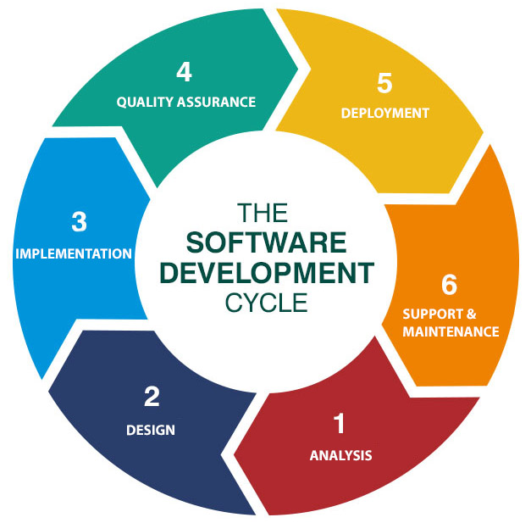
Journey ppt (18/8/23)
Identifying the business needs and gathering the requirements is a part of Business analysis.
Different type of functional and non-functional requirements.
Scenario-based and Class-based use case diagrams.
Scrum flow is the series of processes that teams complete to deliver a product. It includes following events :-
Sprint
Sprint Planning
Daily Scrum
Review
Retrospective

Slide 2
